Slide 1
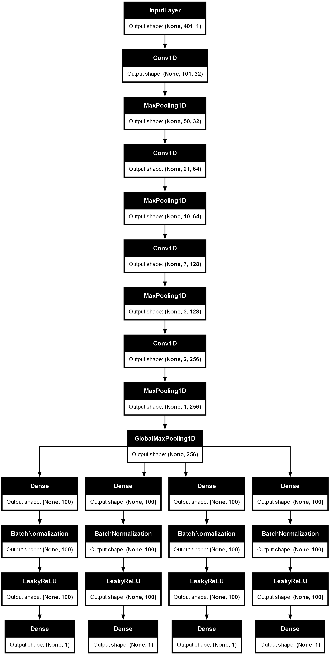
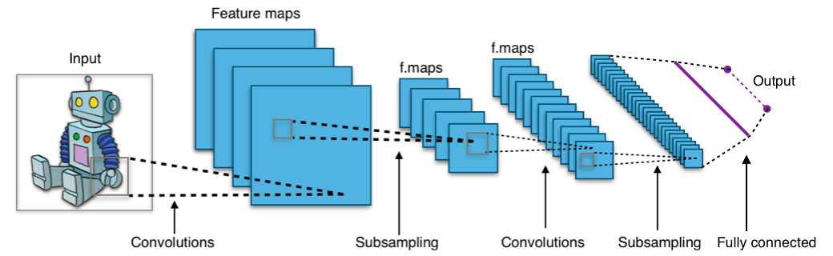
Total params: 227,268 (887.77 KB)
Trainable params: 226,468 (884.64 KB)
LeNet
Common to all architectures

Slide 2
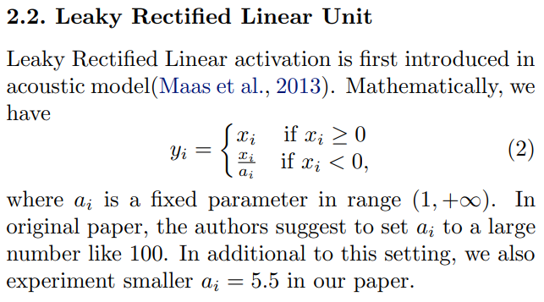
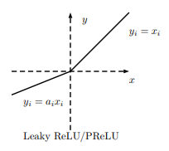
Output layers common to all architectures
Dense implements the operation: output = activation(dot(input, kernel) + bias) where activation is the element-wise activation function passed as the activation argument, kernel is a weights matrix created by the layer, and bias is a bias vector created by the layer (only applicable if use_bias is True).
total_center3 = Dense(1, activation="linear", name="total_center3",kernel_initializer="he_normal")(total_center1_act)
Batch normalization applies a transformation that maintains the mean output close to 0 and the output standard deviation close to 1.
Peak width
Number of peaks
Peak center
Peak amplitude

Slide 3
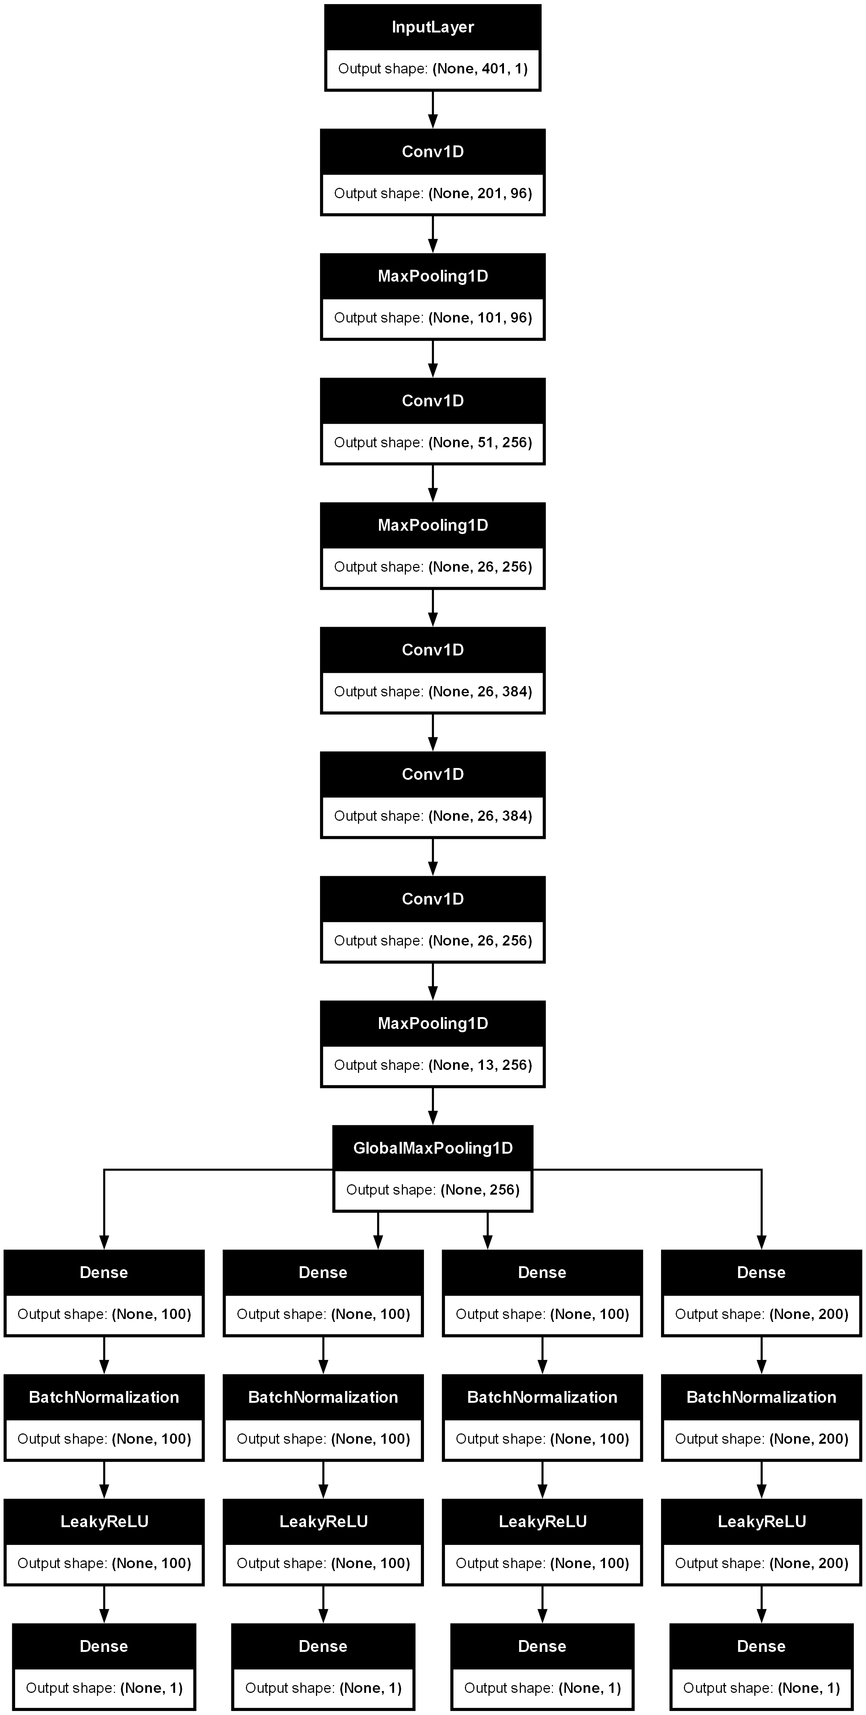
Alex-ZFNet

Slide 4
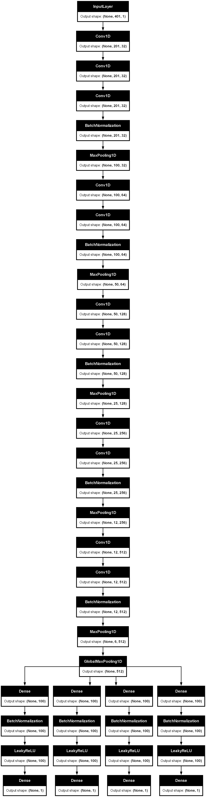
VGGNet (1)

Slide 5
VGGNet (2)

Slide 6
ResNet (1)

Slide 7
ResNet (2)

Slide 8
SENet – SEResNet (1)

Slide 9
SENet – SEResNet (2)

Slide 10
SENet – SEResNet (3)

Slide 11
m-SENet – sparse densenet (1)
transition
SE
Sparse-dense block 1

Slide 12
m-SENet – sparse densenet (2)

Slide 13
m-SENet – sparse densenet (3)

Slide 14
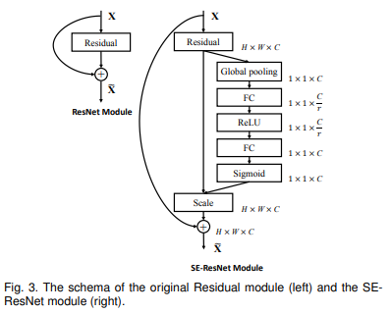
ResNet
SENet – SEResNet
m-SENet – sparse densenet

